Slide 1
AMAZING SYLHET

Slide 2
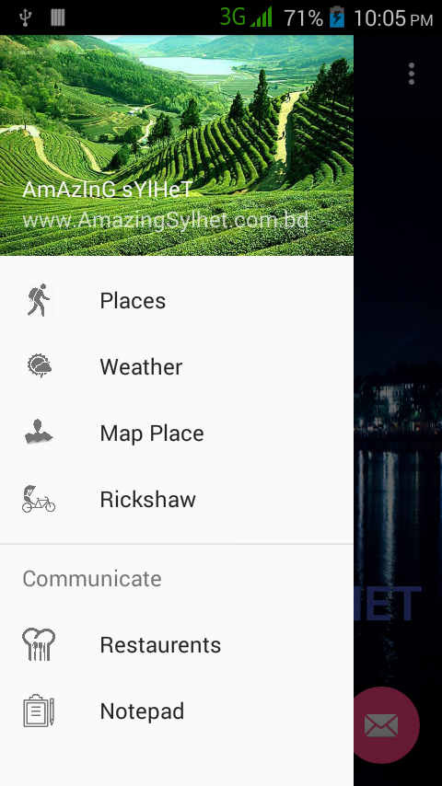
home screen

Slide 3
Features
Places to Visit
Weather Data along with Date and Time
Checking places in Map
Rent of Rickshaw
Popular Restaurants
Notepad

Slide 4
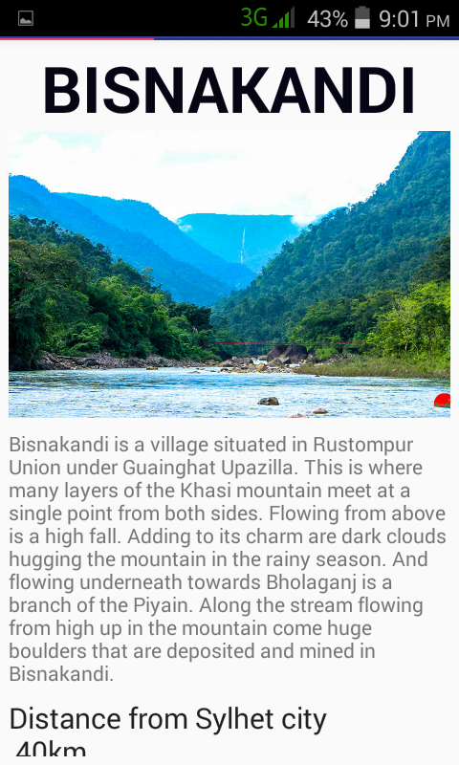
Places to visit in Sylhet
Name of the place
Image of that specific place
Description about the place

Slide 5
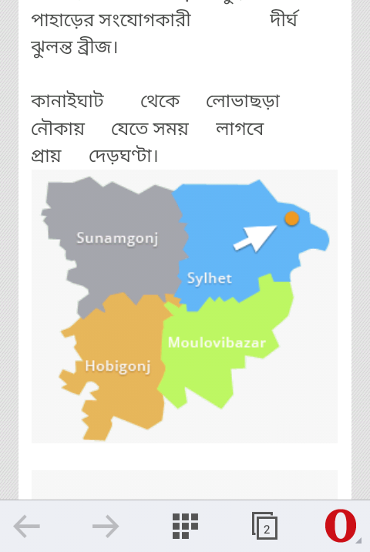
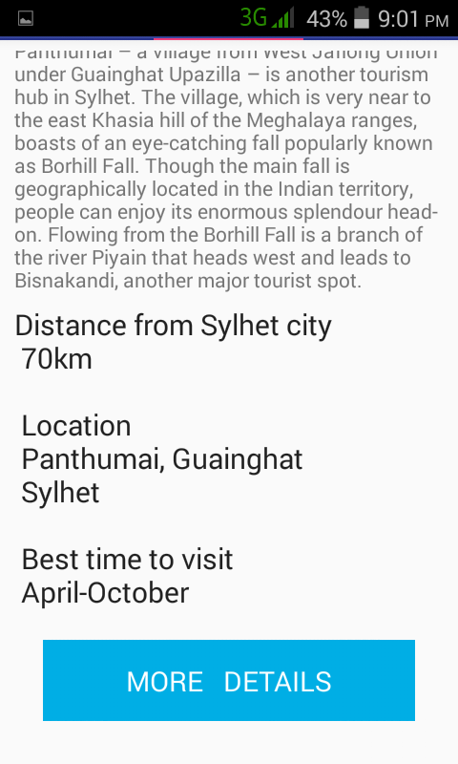
Places to visit in Sylhet
Description about
the place
Detailed information
of that place
More info
Opens in the default browser

Slide 6
Advantages of using Volley Library
Android volley is a HTTP library to make networking calls much easier and most importantly faster.
Automatic scheduling of network request.
Support of request prioritization.
We can cancel a request or block a request.
Ease of customization.
Easily manage UI with data fetched asynchronously from the network.

Slide 7
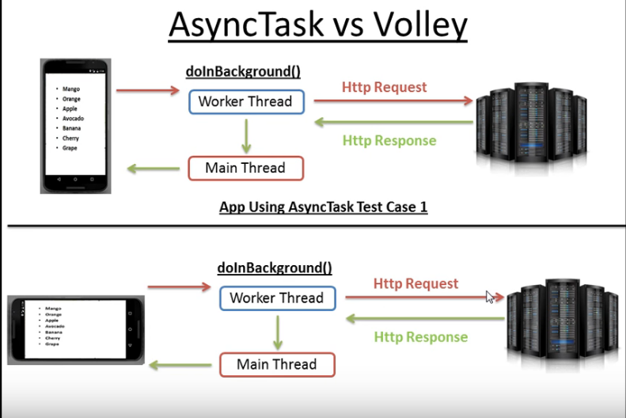
Advantages of using Volley Library
Waste of resources..
Bandwidth
Memory

Slide 8
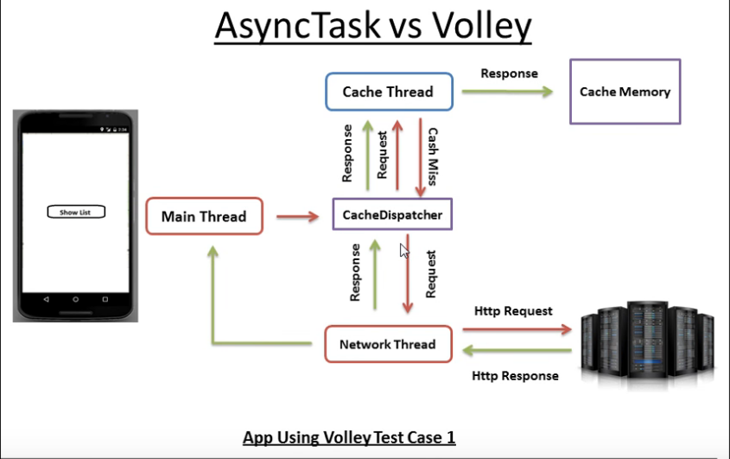
Advantages of using Volley Library
Improves the application performance

Slide 9
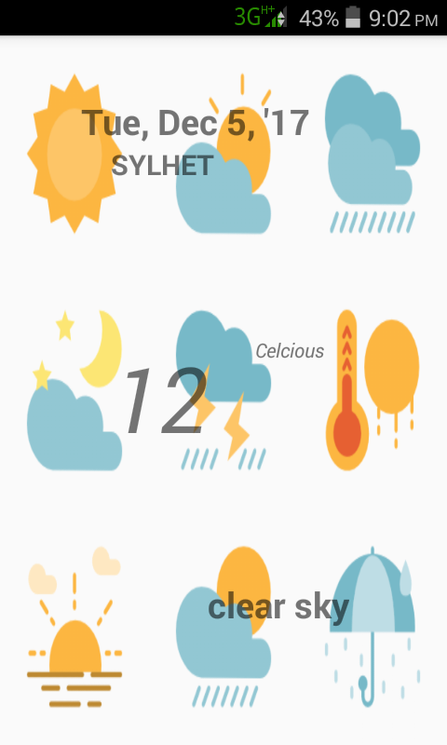
Weather data
Date, along with day of the week and place
Temperature in celsius
Type of the day

Slide 10
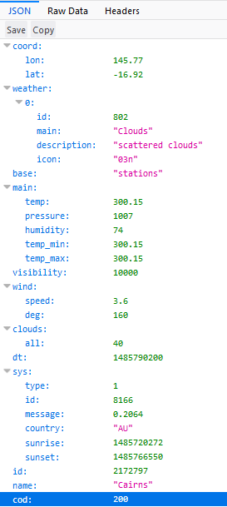
Weather data
Latitude and Longitude of that particular place
Type of that day
Temperature in kelvin
Name of the city

Slide 11
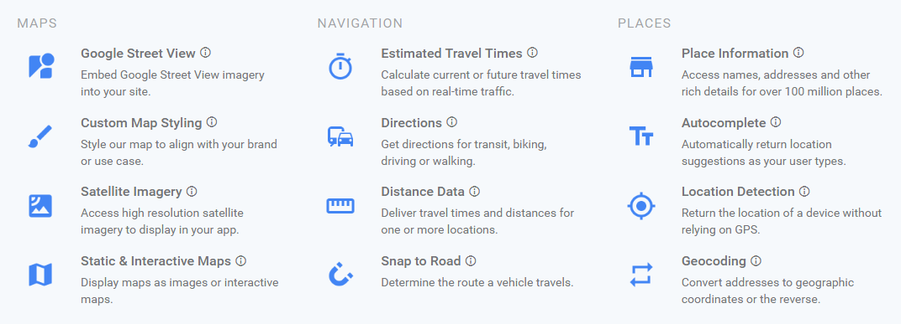
Google Map

Slide 12
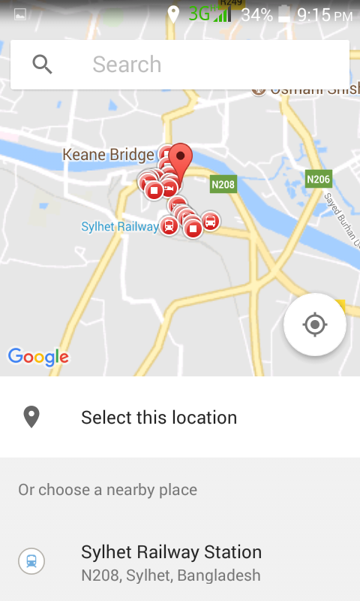
Google Map
use of google place picker api

Slide 13
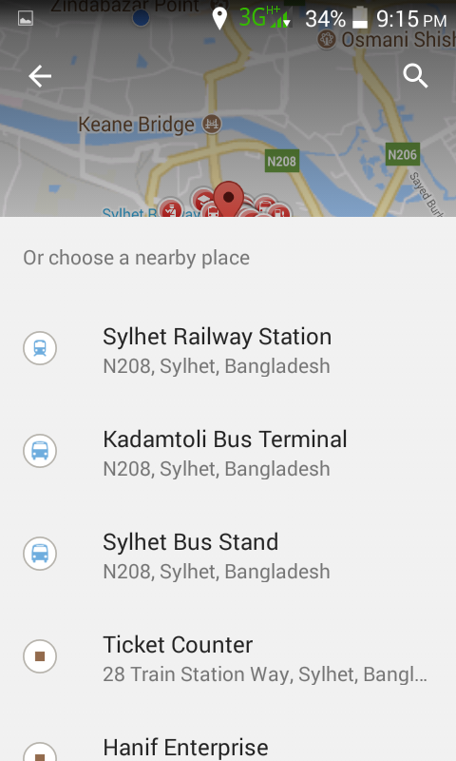
Google Map
use of google place picker api

Slide 14
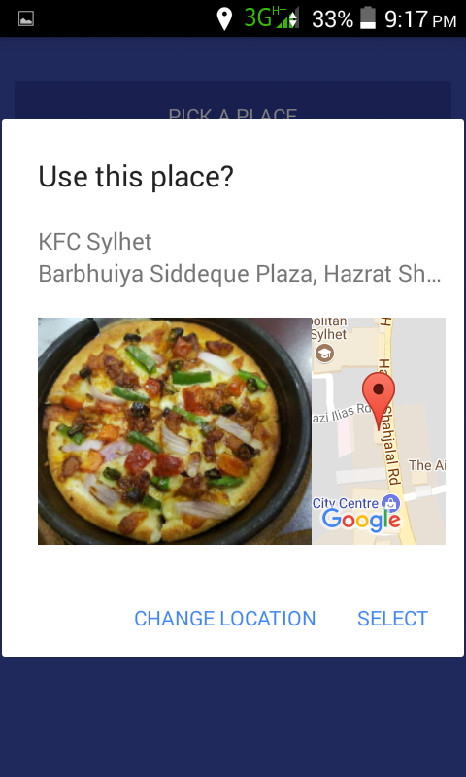
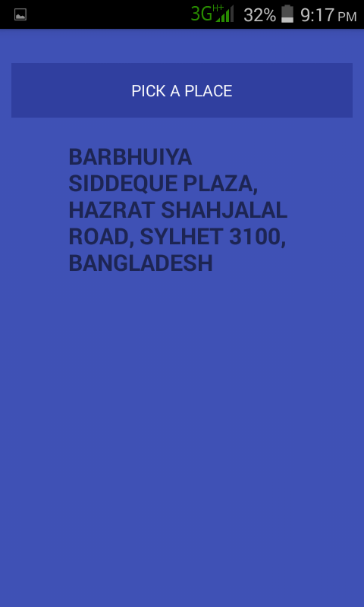
Google Map

Slide 15
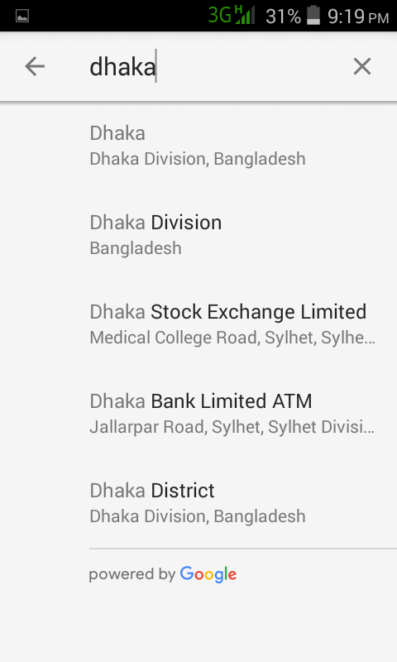
Google Map
places autocomplete api

Slide 16
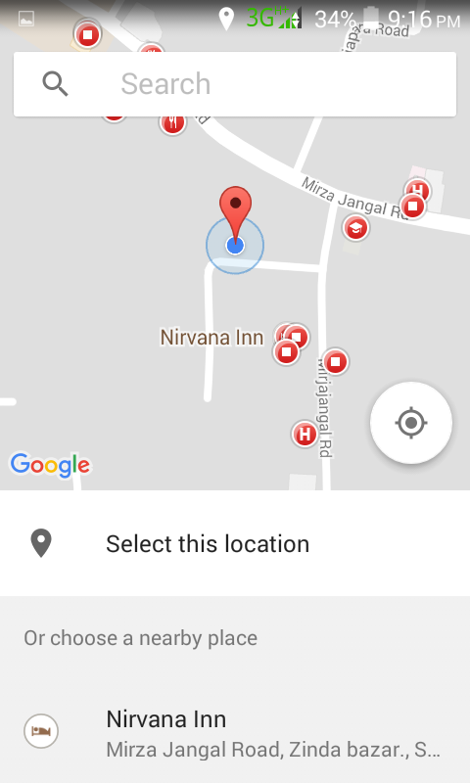
Google Map
use of global positioning system

Slide 17
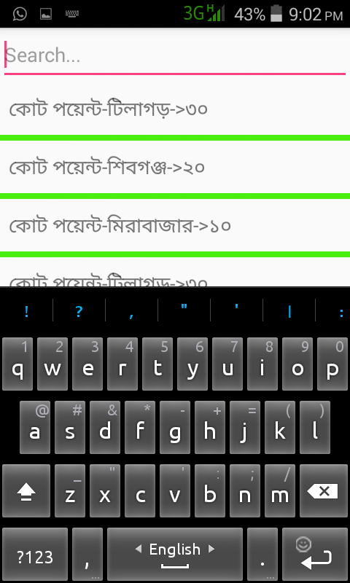
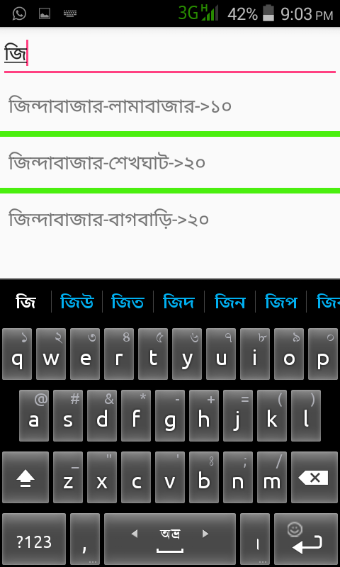
Rent of Rickshaw
Find out the result according to given input
List of rent of rickshaw, based on source to destination

Slide 18
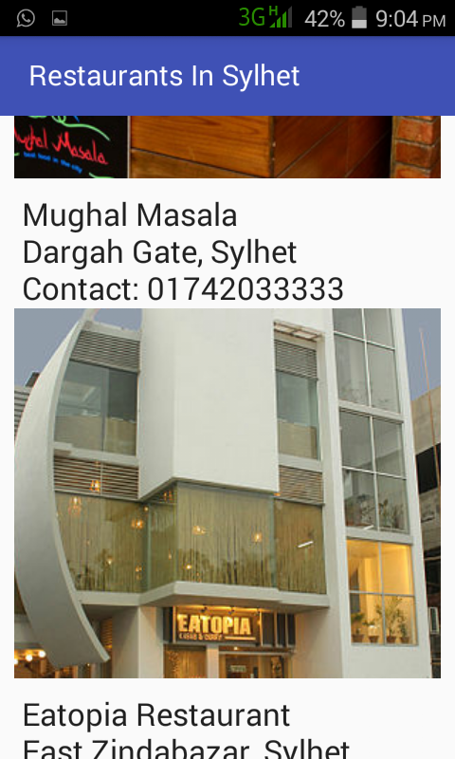
Popular restaurants in Sylhet
Restaurants name
Place
Contact number
Image of the
restaurant

Slide 19
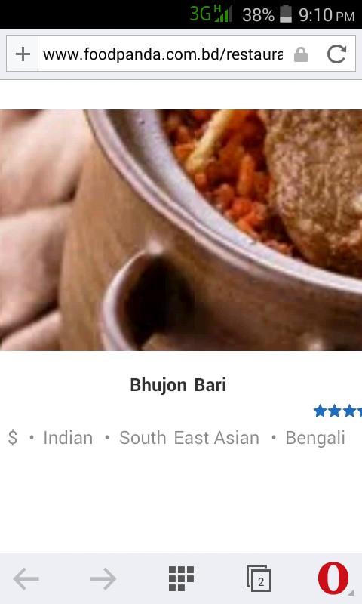
Popular restaurants in Sylhet
Click the image
Enable the user to
watch the menu and order foods

Slide 20
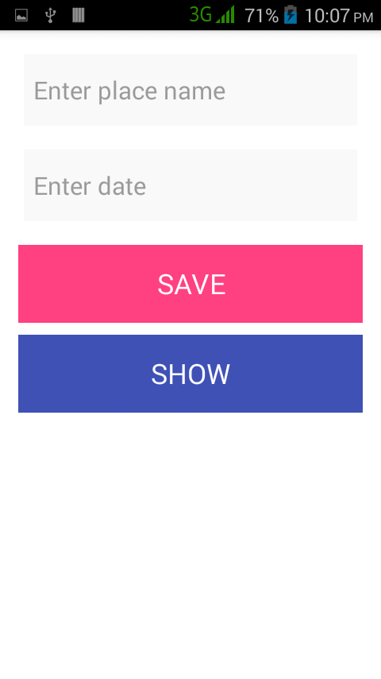
Notepad
SQLite Database
Features:
Create
Retrieve
Update
Delete

Slide 21
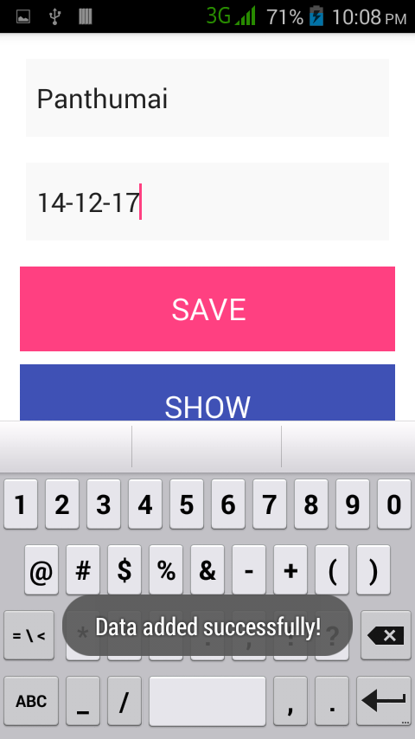
Notepad
SQLite Database
Inserting data

Slide 22
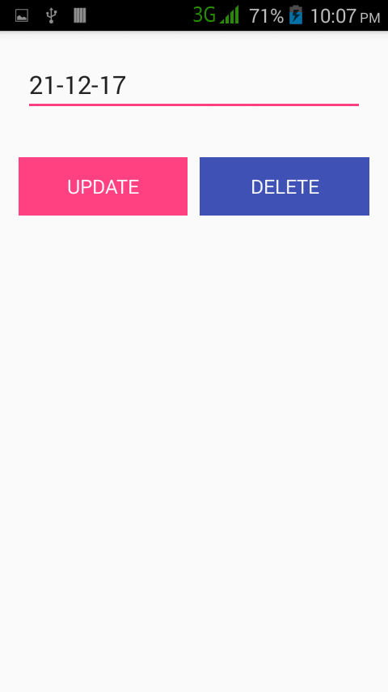
Notepad
SQLite Database
Update option
Delete option

Slide 23
Thanks for watching.

